Slide 1
Turing x UCSB x ACM – AI Product Development Mentorship Program
Turing
February 27, 2026

Slide 2
Agenda
01
02
03
Objectives & Expectations
Schedule Overview
Project Understanding

Slide 3
Objectives. Learn the E2E from idea → architecture → implementing a prototype → presenting demo, using the most relevant tools in the industry in 2026.

Slide 4
Expectations. The students need to spend at least 3 hours outside class per week on the project.

Slide 5
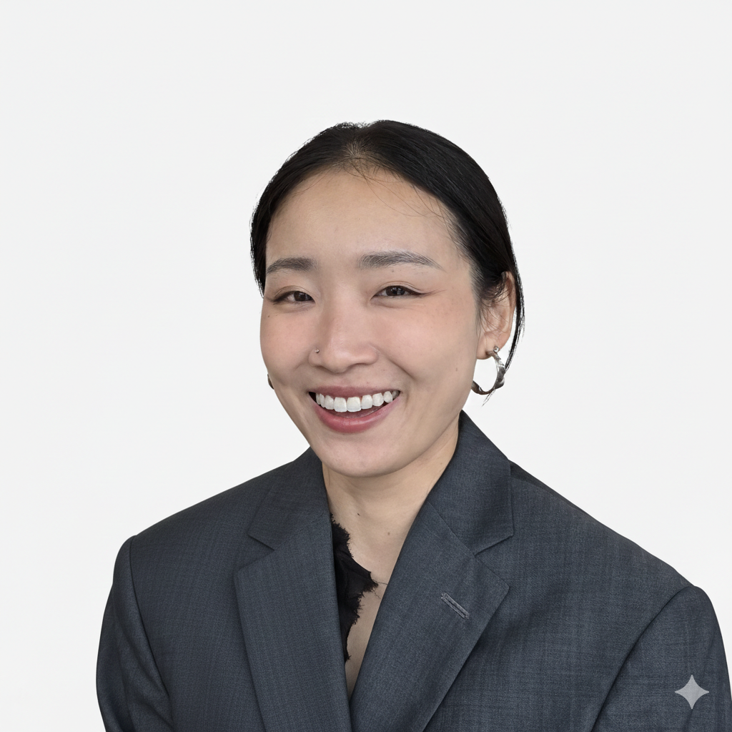
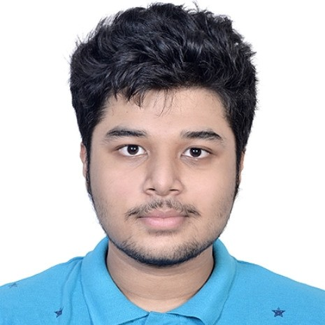
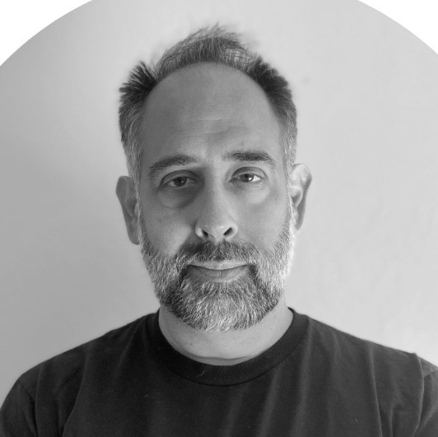

Meet the Industry Advisors
Irene Fan
AI Product Manager, Turing Intelligence
Agnibha Sarkar
Software Engineer, Turing Intelligence
Jason Meil
VP, Head of Products & Solutions
Sinchan Banerjee
Founder of Pear Healthcare, Engineer

Slide 6
Schedule Overview
Subject to change
Week 1 | Course Kickoff + Problem Scoping
Week 2 | Agentic AI & Fundamentals
Week 3 | LangGraph & RAG
Week 4 | HITL Systems
Week 5 | Industry Realities of Building AI Products
Week 6 | Architecture Design & Eng Design Doc
Week 7 | [Student Presentation] Architecture Presentations + Critique
Week 8 | Coding Copilots in Practice & Development Cycle Integration
Week 9 | End-to-end Implementation & Evaluation
Week 10 | [Student Presentation] Demo Week (Final Prototype + Documentation)

Slide 7
Project Initial Context.
CBRE wants to cut spending on call centers.
The call centers are set up to handle building maintenance and repair needs.
CBRE currently has a solution that automates calls, but it’s wrong all the time.

Slide 8

In-Class Notes
Success rate is unknown but we know the current solution calls 911 for many low severity problems
Right now no human can catch the routing mistake before it happens
Our solution will need to integrate with their ticketing system
Transcripts are available
Problem examples: water leakage, door broken, elevator broken, window smashed, etc.
Can we assume there’s a code / category for each problem ?? → we agreed that it’s reasonable to assume there are codes for common problems
Assumption on the current solution: hybrid system - auto-classification on priority urgency → this part is wrong
This new solution will need to use historical data
How?
What? → Parse Entities from Transcript. Call routing history. Outcome of the call.
Client
CBRE

Slide 9
Next steps
March 6
Optional homework: 1-pager business brief

Slide 10
Thank you
Questions? Contact
irenefanyiran@gmail.com

